Slide 1
Generating Insights from Clustering Large Donors
Brad Stieber Data Analyst, Wisconsin Foundation and Alumni Association Brad.Stieber@supportuw.org | bgstieber.github.io

Slide 2
Overview
Background and Context
What is Unsupervised Learning
Three Clustering Algorithms You Should Know
Using Results from Unsupervised Learning
An Example from WFAA
Bonus: Large Donor Disruption in Philanthropy
Wrapping Up
Notes:
First, provide some information about my background, then lay the foundation for talking about UL, and finally discuss
How we’ve used it at WFAA to cluster our large donors, and why that group is so important

Slide 3
Who Am I

Slide 4
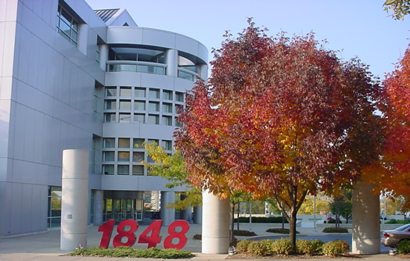

What do I do

Slide 5
Unsupervised Learning

Slide 6
Using UL: Right and Wrong Times

Slide 7
Three Clustering Algorithms You Should Know
K means
Hierarchical Clustering
DBSCAN
Bonus: Dimensionality Reduction
Notes:
DBSCAN-Density-based spatial clustering of applications with noise

Slide 8
K Means
“Hello, world” of clustering algorithms
Simple, yet effective

Slide 9
Hierarchical Clustering

Slide 10
DBSCAN

Slide 11
Bonus: Dimensionality Reduction

Slide 12
Example from WFAA – Setup

Slide 13
Example from WFAA – Data/Methods

Slide 14
Example from WFAA – Results

Slide 15
Example from WFAA – Implementation

Slide 16
Large Donor Disruption

Slide 17
Large Donor Disruption

Slide 18
Large Donor Disruption

Slide 19
Wrapping Up

Slide 20
Wrapping Up

Slide 21
Wrapping Up

Slide 22
Thank You!
Please complete your session evaluations in the mobile app.

